Slide 1
ADA National Network Webinar Series: Disparities in COVID-19 vaccination status and access for people with disabilities Blythe Ryerson, PhD, MPH Division Director (Acting) Division of Human Development and Disability
November 9, 2021

Slide 2
Overview
Background on COVID-19 and people with disabilities
Disability disparities in COVID-19 vaccine status and access
National Immunization Survey
Household Plus Survey
Implications
Conclusion

Slide 3
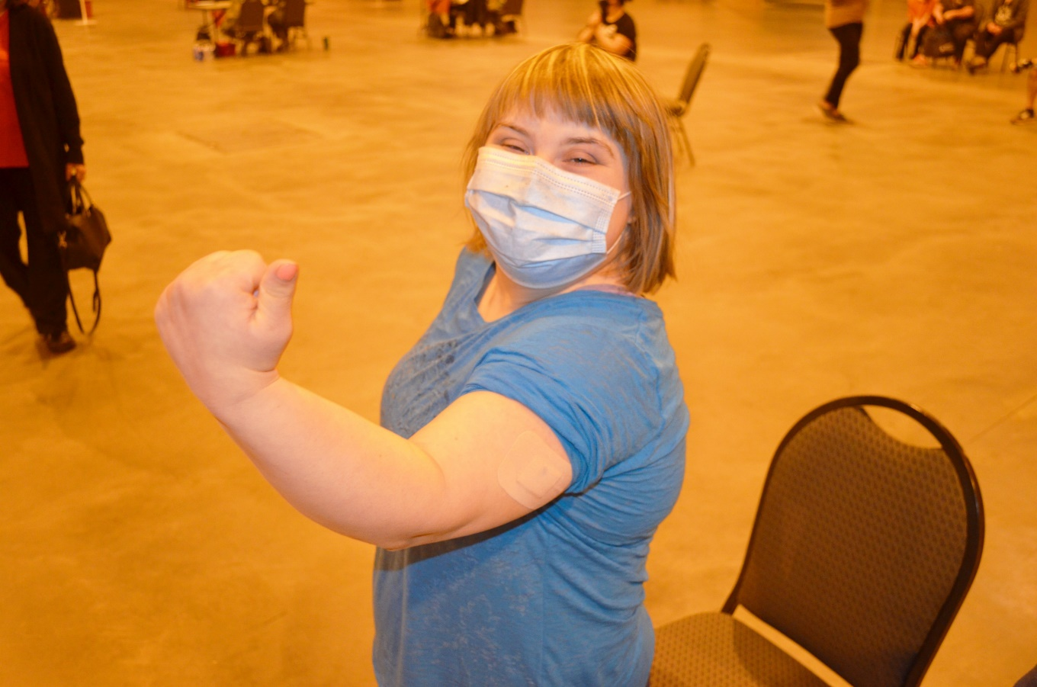
Background

Slide 4
Disability
CDC estimates the prevalence of functional limitations (disability) vary from between 1 in 4 to 1 in 10 adults.
Adults with disabilities report mental distress almost 5 times as often as adults without disabilities.
Adults with disabilities are more likely to have some health conditions that may put them at higher risk of severe illness from COVID-19.
https://www.cdc.gov/ncbddd/disabilityandhealth/dhds/
https://wwwn.cdc.gov/NHISDataQueryTool/ER_Quarterly/index_quarterly.html

Slide 5
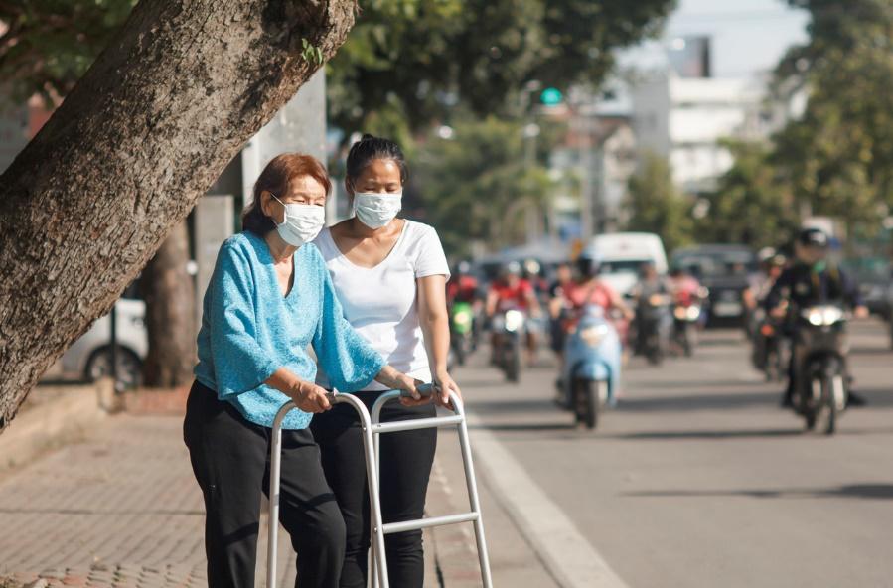
COVID-19 and People with Disabilities
Social inequities and other characteristics increase risk of COVID-19 and severe outcomes for some people with disabilities:
Chronic health conditions
Living in congregate settings
Increased barriers to health care
Limited mobility
Require direct support or care
Trouble understanding or practicing preventive measures
Challenges with communicating symptoms of illness
https://www.cdc.gov/coronavirus/2019-ncov/need-extra-precautions/people-with-disabilities.html
https://www.cdc.gov/coronavirus/2019-ncov/need-extra-precautions/people-with-medical-conditions.html

Slide 6
COVID-19 Diagnosis and People with Disabilities
Gleason J, et al. The devastating impact of COVID-19 on individuals with intellectual disabilities in the United States. NEJM Catalyst 2021

Slide 7
COVID-19 Admissions and People with Disabilities
Gleason J, et al. The devastating impact of COVID-19 on individuals with intellectual disabilities in the United States. NEJM Catalyst 2021

Slide 8
COVID-19 Mortality and People with Disabilities
Gleason J, et al. The devastating impact of COVID-19 on individuals with intellectual disabilities in the United States. NEJM Catalyst 2021

Slide 9
Measuring Disability – Conceptual Framework
Measuring Disability
Birth
defects
Developmental disabilities
Acquired
disabilities
Underlying medical conditions
May affect various activities or domains
Vision
Social relationships
Hearing
Thinking
Remembering
Mental health
Movement
Communicating
Learning

Slide 10
Measuring Disability – HHS Standard
HHS Implementation Guidance on Data Collection Standards for Race, Ethnicity, Sex, Primary Language, and Disability Status:
Are you blind or do you have serious difficulty seeing, even when wearing glasses?
Are you deaf or do you have serious difficulty hearing?
5 years old or older:
Because of a physical, mental, or emotional condition, do you have serious difficulty concentrating, remembering, or making decisions?
Do you have serious difficulty walking or climbing stairs?
Do you have difficulty dressing or bathing?
15 years old or older:
Because of a physical, mental, or emotional condition, do you have difficulty doing errands alone such as visiting a doctor’s office or shopping?
https://aspe.hhs.gov/reports/hhs-implementation-guidance-data-collection-standards-race-ethnicity-sex-primary-language-disability-0

Slide 11
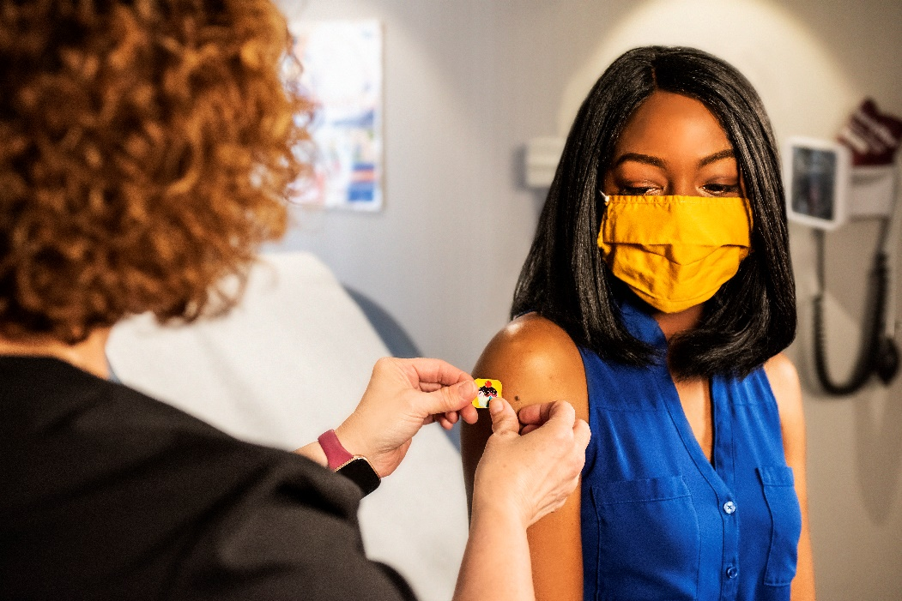
Disability Disparities in COVID-19 Vaccine Status & Access National Immunization Survey

Slide 12
Recent Publication
Ryerson AB, Rice CE, Hung M, et al. Disparities in COVID-19 Vaccination Status, Intent, and Perceived Access for Noninstitutionalized Adults, by Disability Status — National Immunization Survey Adult COVID Module, United States, May 30–June 26, 2021. MMWR Morb Mortal Wkly Rep 2021;70:1365–1371. DOI: http://dx.doi.org/10.15585/mmwr.mm7039a2.

Slide 13
Adult COVID Module (ACM)
National Immunization Survey is a group of surveys used to monitor vaccination coverage
An Adult COVID Module was added in April 2021 in response to the COVID-19 pandemic
Telephone interviews of adults ≥18 years of age
Random-digit-dialed sample of cell phones stratified by locality
Limited to non-institutionalized adults
https://www.cdc.gov/vaccines/imz-managers/nis/about.html

Slide 14
ACM Measure of Disability
Do you have serious difficulty seeing, hearing, walking, remembering, making decisions, or communicating?
Yes
No
Don’t Know
Refused
https://www.cdc.gov/vaccines/imz-managers/nis/downloads/NIS-ACM-Questionnaire-Q2-2021_508.pdf

Slide 15
MMWR Methods
Responses weighted to represent the non-institutional U.S. population
Calibrated to state-level vaccine administration data
Unadjusted and age-adjusted analyses conducted to detect differences between adults with and without a disability
Percentages (t-tests)
Prevalence ratios (logistic regression and predictive marginals)
https://www.cdc.gov/coronavirus/2019-ncov/need-extra-precautions/people-with-disabilities.html
https://www.cdc.gov/coronavirus/2019-ncov/need-extra-precautions/people-with-medical-conditions.html

Slide 16
MMWR Results – Vaccination Coverage & Intent
9.4% of respondents reported having a disability
Adults with a disability were less likely to report receiving ≥1 dose of a COVID-19 vaccine (aPR=0.88, 95% CI:0.84–0.93)
Adults with a disability were more likely to report they would get vaccinated (aPR=1.86, 95% CI: 1.43–2.42)

Slide 17
MMWR Results – Attitudes & Perceptions
Age-adjusted prevalence ratios of COVID-19 vaccine attitudes, perceptions, and recommendations among adults aged ≥18 years with a disability compared with adults without a disability, by COVID-19 vaccination status — National Immunization Survey Adult COVID Module, United States, May 30–June 26, 2021

Slide 18
MMWR Results – Experiences & Difficulties
Age-adjusted prevalence ratios of experiences and difficulties with getting COVID-19 vaccine among adults aged ≥18 years with a disability compared with adults without a disability, by COVID-19 vaccination status — National Immunization Survey Adult COVID Module, United States, May 30–June 26, 2021
Made/makes it difficult to get the COVID-19 vaccine

Slide 19
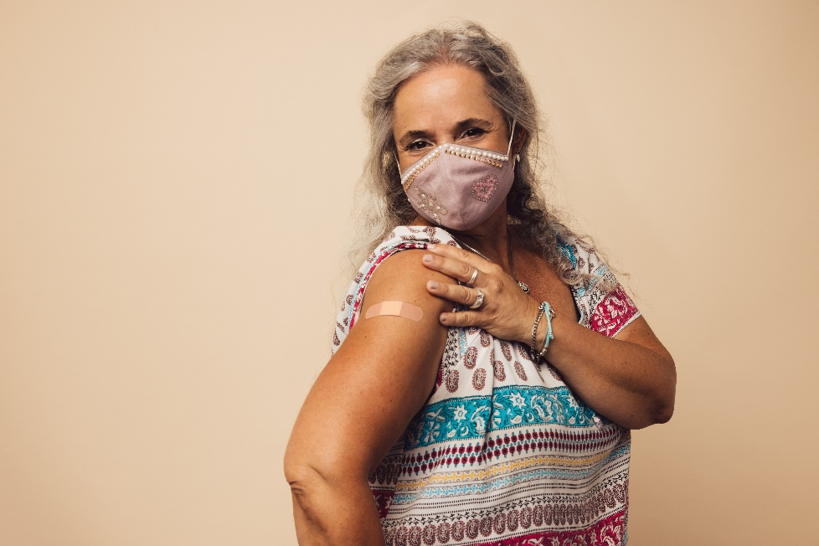
Disability Disparities in COVID-19 Vaccine Status & Access Household Pulse Survey

Slide 20
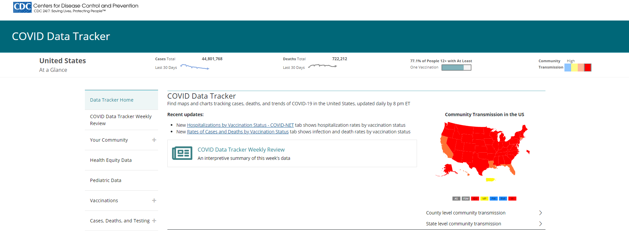
Disability Data on CDC COVID Data Tracker
https://covid.cdc.gov/covid-data-tracker/#datatracker-home

Slide 21
Household Pulse Survey (HPS)
20-minute online survey of adults ≥ 18 years of age on how the pandemic is impacting households across the country from a social and economic perspective
Sponsored by the U.S. Census Bureau
Study sample generated from the Census’ Master Address File
Individuals were contacted by phone/email and invited to complete the online questionnaire
In collaboration with CDC, disability questions were added in the 3rd phase of the survey, starting April 14, 2021
https://www.census.gov/data/experimental-data-products/household-pulse-survey.html

Slide 22
HPS Disability Questions
Collecting 4 of the 6 Washington Group Short Set on Functioning questions
Do you have difficulty seeing, even when wearing glasses?
Do you have difficulty hearing, even when using a hearing aid?
Do you have difficulty remembering or concentrating?
Do you have difficulty walking or climbing stairs?
No – no difficulty
Yes – some difficulty
Yes – a lot of difficulty
Cannot do at all
https://www.washingtongroup-disability.com/fileadmin/uploads/wg/Documents/Questions/Washington_Group_Questionnaire__1_-_WG_Short_Set_on_Functioning.pdf

Slide 23
HPS Methods
New random samples are selected and released for each survey wave, and responses are accepted during the data collection period
Responses weighted to represent the non-institutional U.S. population
https://www.census.gov/programs-surveys/household-pulse-survey.html

Slide 24
HPS Disability & Vaccination Results – by Age Group
Reported receipt of 1 or more doses of COVID-19 vaccine among adults age ≥18 years by disability status and age group, Household Pulse Survey, conducted September 1–September 27, 2021, United States*
*Online Pulse data are updated approximately every 2 weeks
https://covid.cdc.gov/covid-data-tracker/#vaccinations-disability-status, accessed 10/18/2021

Slide 25
HPS Disability & Vaccination Results – by Disability Type
Reported receipt of 1 or more doses of COVID-19 vaccine among adults age ≥18 years by disability status and disability type, Household Pulse Survey, conducted September 1–September 27, 2021, United States*
*Online Pulse data are updated approximately every 2 weeks
https://covid.cdc.gov/covid-data-tracker/#vaccinations-disability-status, accessed 10/18/2021

Slide 26
HPS Disability & Vaccination Results – by Intent
Reported receipt of 1 or more doses of COVID-19 vaccine and intention to get vaccinated among adults age ≥18 years by disability status, Household Pulse Survey, conducted September 1–September 27, 2021, United States*
*Online Pulse data are updated approximately every 2 weeks
https://covid.cdc.gov/covid-data-tracker/#vaccinations-disability-status, accessed 10/18/2021

Slide 27
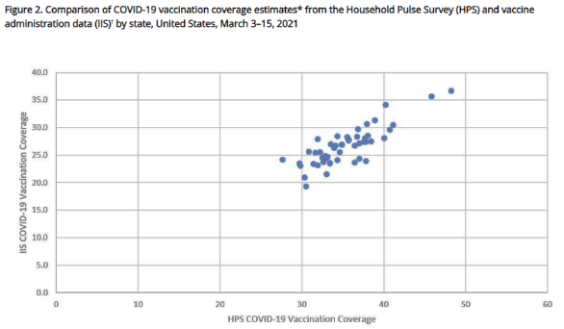
NIS-ACM and HPS Limitations
*COVID-19 vaccination administrative data can come from:
Immunization information systems (IIS),
Vaccine Administration Management System (VAMS), and/or
Direct data submissions from federal agencies and pharmacies
Self-report vaccination coverage higher than administrative sources*
Self-report may not accurately reflect actual vaccination status
Low response rates (18.9% for NIS; 9% for Pulse)
Exclusion of certain households and institutionalized populations
Still a strong positive association between data sources – important supplement for comparing relative coverage among subpopulations
Unvalidated (NIS) or incomplete (Pulse) disability status measurement
https://www.cdc.gov/vaccines/imz-managers/coverage/adultvaxview/pubs-resources/covid19-coverage-estimates-comparison.html

Slide 28
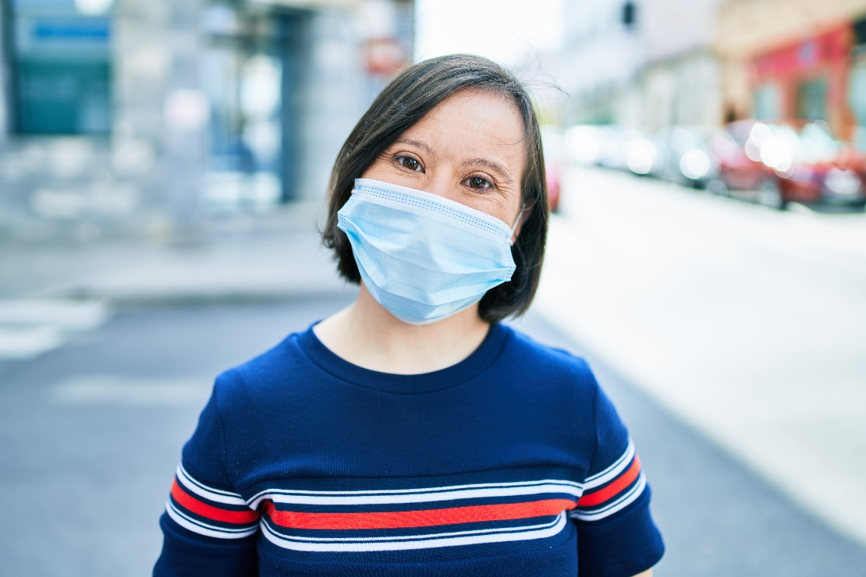
Implications

Slide 29
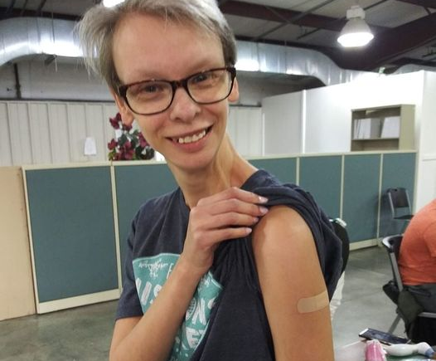
Disability Disparities in COVID-19 Vaccine Coverage
Compared to adults without a disability, adults with a disability:
Had lower COVID-19 vaccination coverage
Were less hesitant to get vaccinated
Were more likely to think the vaccine is important for protection
There might be potential for increasing vaccination coverage for adults with a disability

Slide 30
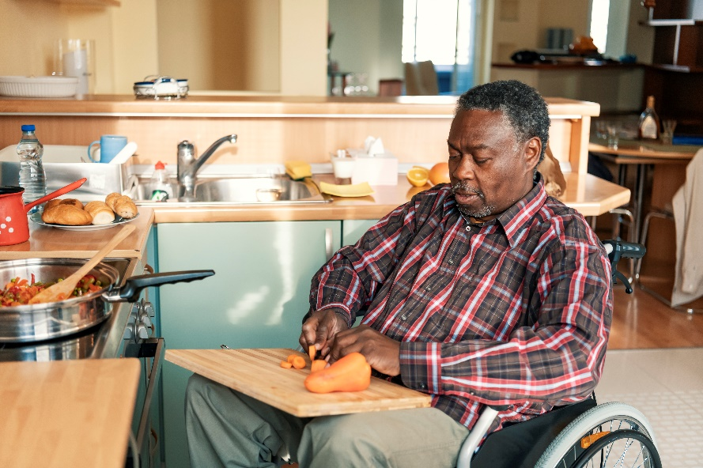
Disability Disparities in COVID-19 Vaccine Access
Compared to adults without a disability, adults with a disability:
Anticipated or experienced more difficulty obtaining a vaccination
Getting an appointment online
Not knowing where to get vaccinated
Getting to vaccination sites
Vaccination sites not being open at convenient times
Reducing barriers to scheduling and making vaccination sites more accessible might improve vaccination rates among people with disabilities

Slide 31
What can be done?
Improved accessibility of COVID-19 health messages
American Sign Language (ASL)
Braille
Easy-to-read formats
Low literacy formats
Make vaccination registration and scheduling websites more accessible
Provide call-lines for people unable to navigate or use online systems
Ensure people have access to fully accessible vaccination services such as:
ASL interpreters
Providers trained to work with people with intellectual or other developmental disabilities
Provide options for in-home vaccination or accessible transportation services

Slide 32
CDC’s Efforts to Improve Vaccination Accessibility
Adaptation of COVID-19 health messages into more accessible formats
Providing Strategies for Reaching People with Limited Access to COVID-19 Vaccines based on feedback from listening sessions with jurisdictions
Approximately $100M provided to Administration for Community Living to:
Create national Disability Information and Access Line (DIAL)
Provide grants to aging/disability networks in all states and territories to
Aid with scheduling appointments
Providing direct support services needed to attend appointments
Providing transportation to vaccination sites
Connecting persons unable to leave their homes independently to in-home vaccination options

Slide 33
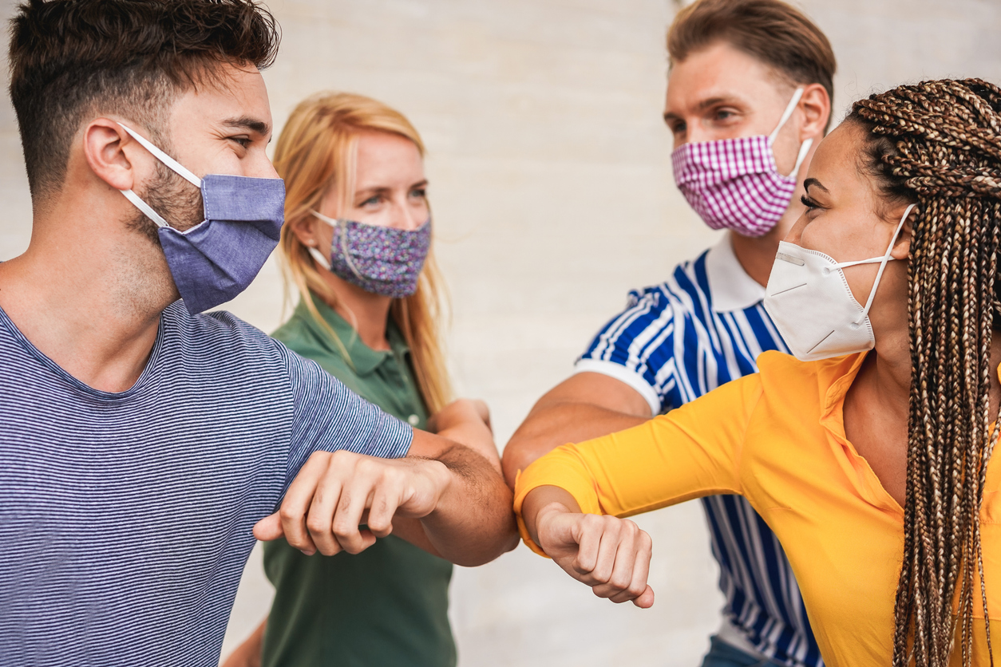
Conclusion

Slide 34
Summary
People with disabilities are at increased risk for COVID-19 related illness and death.
Compared to adults without a disability, those with a disability are less likely to report having had a COVID-19 vaccine, despite being less likely to report hesitancy.
Adults with a disability report more difficulties obtaining a COVID-19 vaccine than adults without a disability.
Reducing barriers to scheduling and making vaccinations sites more accessible might improve COVID-19 vaccination coverage among people with disabilities.

Slide 35
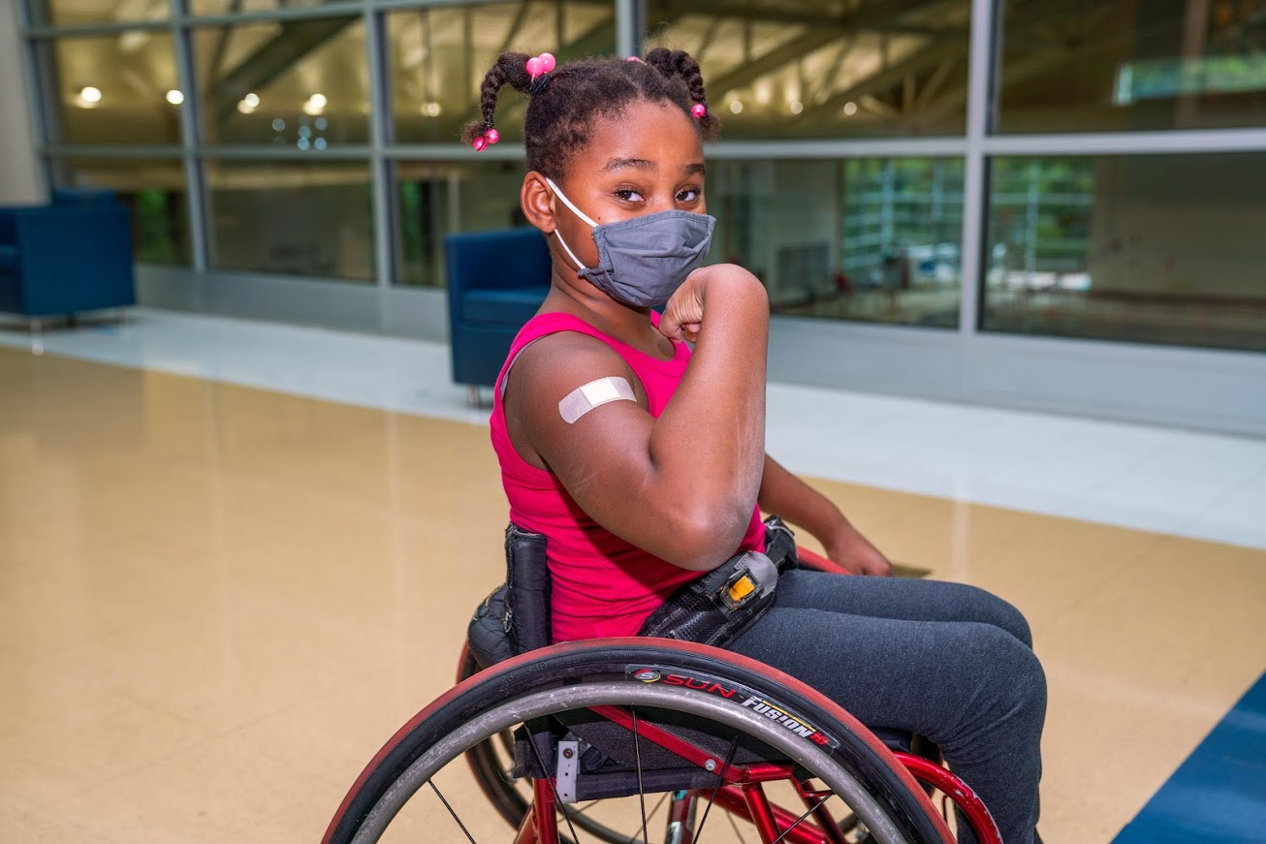
Acknowledgements
Cathy Rice
Mei-Chuan Hung
Suchita Patel
Julie Weeks
Jennifer Kriss
Georgina Peacock
Pent-Jun Lu
Amimah Asif
Hannah Jackson
Jim Singleton
Julia Falvey
Carla Black
Cindi Knighton
Ashley Tippins
Tammy Santibanez

Slide 36
Thank you!

Slide 37
Vaccine Site Accessibility
J.J. Rico, CEO
Arizona Center for Disability Law
November 12, 2021

Slide 38
Americans with Disabilities Act (ADA)
Prohibits discrimination in the services, programs, and activities by covered entities.
Covered entities: State and Local Government (Title II), Places of Public Accommodation, e.g. businesses, healthcare organizations, doctors offices, vaccine sites (Title III)
Reasonable modifications/accommodations: a change to how things are typically done, that will provide individuals with disabilities equal opportunity to participate in the services, programs, and activities covered by the covered entity.

Slide 39
Planning Ahead – Appointments and Scheduling
Accessible registration websites.
Alternative registration processes (call-in line).
Group scheduling helps for people with caregivers.
Provide videos ahead of time.
Offer disability rights training for volunteers/staff.
Appointment process should include opportunity to request reasonable accommodations.

Slide 40
Some recommendations to ensure accessibility
Site and Day of Vaccine Accessibility
-Registration and accommodation information needs to be accessible
ADA accessible bathrooms
Adequate parking including van accessible parking
Sensory items and sensory options
Keep wheelchairs and places to sit on hand
In-car vaccinations
Lots of signage
Plain language signage w/ photos

Slide 41
ADA and Effective Communication
“People who have vision, hearing, or speech disabilities (“communication disabilities”) use different ways to communicate.” – U.S. Dept. of Justice
Have lots of tools in your tool box.
Provide fact sheets on vaccine ingredients, side effects in a variety of formats.
Communication cards for people who are deaf and hard of hearing.
Wear clear masks for people who read lips.

Slide 42
Resources
Site accessibility: https://www.adachecklist.org/doc/fullchecklist/ada-checklist.pdf
Web accessibility: https://www.w3.org/WAI/standards-guidelines/wcag/
Office for Civil Rights: https://www.hhs.gov/sites/default/files/federal-legal-standards-prohibiting-disability-discrimination-covid-19-vaccination.pdf

Slide 43
Contact Information
J.J. Rico
CEO jrico@azdisabilitylaw.org

